Slide 1
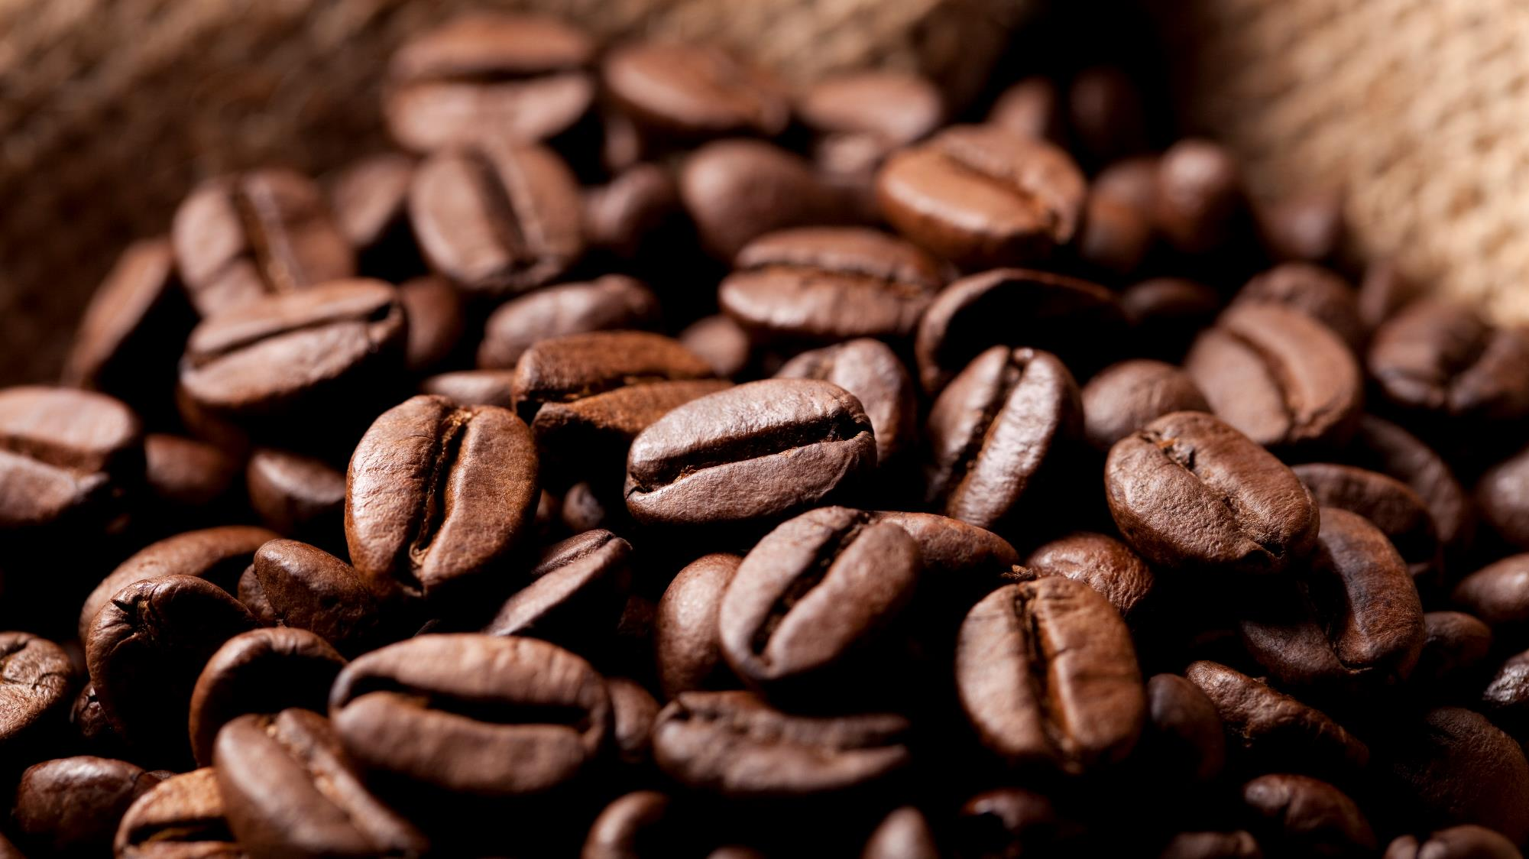
Bright coffee shop analysis
Presenter: Ndadlana Piet Maseko

Slide 2
Outline
Introduction
Problem statement
Objectives
Results
Conclusion
Recommendations

Slide 3
Introduction
About:
Bright Coffee Shop is a retail establishment dedicated to serving customers with high quality products and exceptional service. It focuses on delivering a consistently excellent experience to every visitor.
Our locations are; Astoria, Hell’s kitchen and Lower Manhattan

Slide 4
Problem statement
Bright coffee shop is currently experiencing limited revenue growth and unacceptable product performance, which hinders its competitiveness and ability to meet market demands.

Slide 5
Objectives
Which products generate the most revenue.
What time of day the store performs best.
Sales trends across products and time intervals.
Recommendations for improving sales performance.

Slide 6
Results
Total sales from 01 Jan to 30 Jun 2023 were 698 812
Sales by location:
1. Astonia makes 33% of the sales.
2. Manhattan makes 33% of the sales.
3. Hell’s Kitchen makes 34% of the sales.

Slide 7
January 2023 makes low sales (summer month) February 2023 sales dips further down for all stores March to April 2023 sales starts gaining momentum May to June 2023 sales peak (winter months)

Slide 8
Caffee accounts 39% of total sales
Tea contributes 28% of total sales
Bakery products made up 12% of sales
Drinking chocolate represents 10% of sales
Coffee beans contributes 6% of sales
Branded products accounts for 2% of sales
Packaged chocolate, loose tea and flavours each contributes 1%.

Slide 9
Best selling products are:
Sustainably Grown Organic Lg, with 3.03%
Dark chocolate Lg, with 3.01%
Latte Rg, with 2.73%
Cappuccino Lg, with 2.52%
Morning sunrise chai Lg, with 2.49%
Worst selling products are:
Dark chocolate, with 0.11%
Earl Grey, with 0.18%
Spicy Eye Opener Chai, with 0.19%
Gautemalan Sustainably Grown, with 0.19%
Lemon Grass, with 0.19%

Slide 10
Morning sales: 00:00:00 to 11:59:59
Highest sales across the stores
Afternoon sales: 12:00:00 to 16:59:59
Sales decrease substantially
Evening: 17:00:00 to 23:59:59
Sales reaches the lowest across all the stores

Slide 11
Monday: highest sales recorded
Tuesday, sales declined significantly
Wednesday to Friday, gradual increase in sales momentum
Weekend, lower overall sales, with Saturday recording the lowest

Slide 12
Conclusion
Coffee generates the highest revenue, contributing 39% of the total sales.
Mornings account for 56% of the overall sales performance.
Sales were lower during the summer months and gradually increased as winter approached (June 2023). The total sales per store were;
Astoria: 33%
Lower Manhattan: 33%
Hell’s kitchen: 34%

Slide 13
Recommendations
Make combo deals with coffee as part to increase sales of other products
Make sure there is always enough staff on peak times (Mornings) and introduce specials
Make promotions on non peak hours (Evenings)
Replicate what is happening at Hell’s kitchen to other stores since it caries large portions of sales
Introduce products that will blend well with other seasons

Slide 14
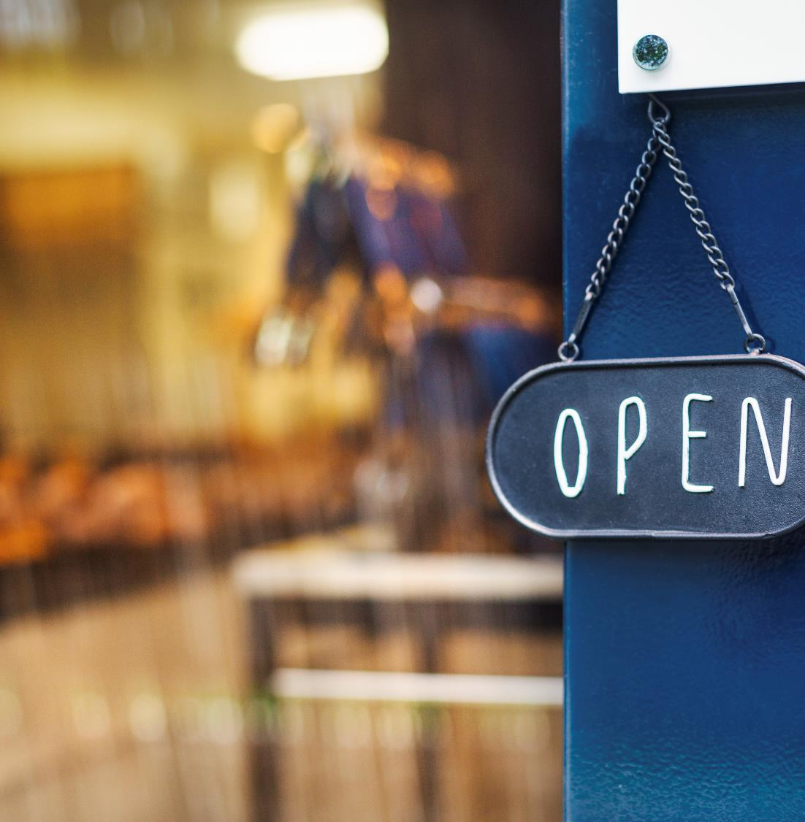

Thank You
Email masekondadlana@gmail.com

